Slide 1
IBM University Engagement Project Submission
“Exploring the Power of Machine Learning with IBM Cloud”

Slide 2

Project Title – SecureNetAI, ML-Powered Network Intrusion Detection System
Domain of Project – Cybersecurity/Network Security
Student Name | Recent Passport Photo | Email ID | Mobile number [WhatsApp]
Raagav Krishnan |  | srksjpuc716raag@gmail.com | +91 7348860439

Slide 3
Problem Statement -
Problem Statement: Network Intrusion Detection using Machine Learning
Organizations and network administrators face increasing difficulty in identifying malicious or anomalous network traffic among massive volumes of legitimate connections. Traditional rule-based intrusion detection systems struggle to keep up with evolving attack patterns and often fail to generalize to novel or subtle threats. Manual monitoring of network logs is time-consuming, error-prone, and does not scale with the volume of modern network traffic. Your task is to design, build, and evaluate a machine learning model that can accurately classify network connections as normal or anomalous based on connection-level features such as protocol type, service, byte counts, error rates, and host-level statistics. The goal is to create a reliable, automated system that can support security teams in detecting intrusions early, reducing response time, and minimizing the risk of undetected cyberattacks such as DoS, probing, and unauthorized access attempts.

Slide 4
Proposed Solution -
IBM watsonx.ai Studio – Auto AI:
We propose an AI-powered Network Intrusion Detection System, SecureNet AI, using IBM watsonx.ai Studio and Auto AI. Network traffic connection data (protocol type, service, flag, byte counts, connection counts, error/rejection rates, host-level statistics, etc.) sourced from the NSL-KDD dataset will be uploaded to watsonx.ai. Auto AI will automatically perform data preprocessing, feature engineering, algorithm selection, and hyperparameter optimization across multiple candidate algorithms (Random Forest, XGBoost, LGBM, Logistic Regression, Snap Decision Tree, and others).Multiple classification pipelines will be generated and evaluated to identify the best-performing model for binary intrusion detection (normal vs. anomaly).
The selected model will be deployed as a live REST API on IBM Cloud, and paired with IBM Granite (foundation model) to generate plain-English explanations for each flagged connection turning raw predictions into actionable security insights for end users.

Slide 5
Technology Used
IBM Cloud: It provides the infrastructure to build, deploy, and scale the SecureNetAI intrusion detection agent efficiently. IBM Cloud enables a reliable, secure, and scalable environment for deploying the network intrusion detection model and its explanation layer.
ML Algorithm/Model Used: Decision Tree Classifier(selected by IBM watsonx.ai AutoAI)
Accuracy Obtained: 0.998(Holdout)
Enhancements and Hyperparameter Tuning: AutoAI's runtime-optimized algorithm and hyperparameter search was applied across multiple candidate models; IBM Granite (granite-3-8b-instruct) was integrated as a post-prediction explanation layer to improve interpretability of flagged anomalies.

Slide 6
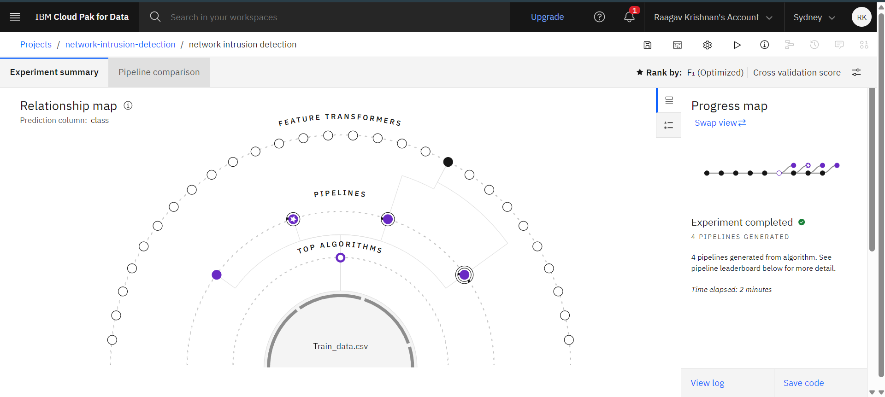
Training Screenshots-

Slide 7
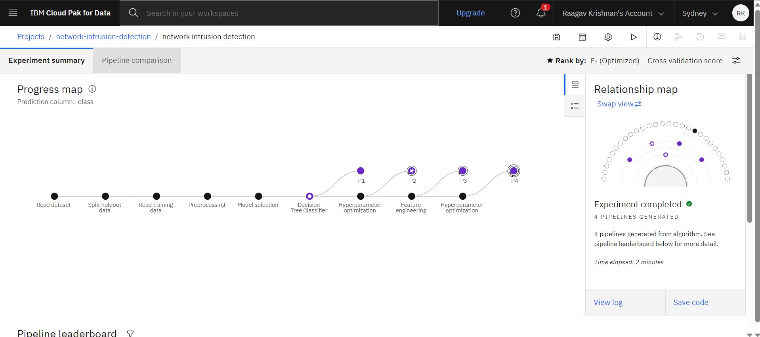
Training Screenshots-

Slide 8
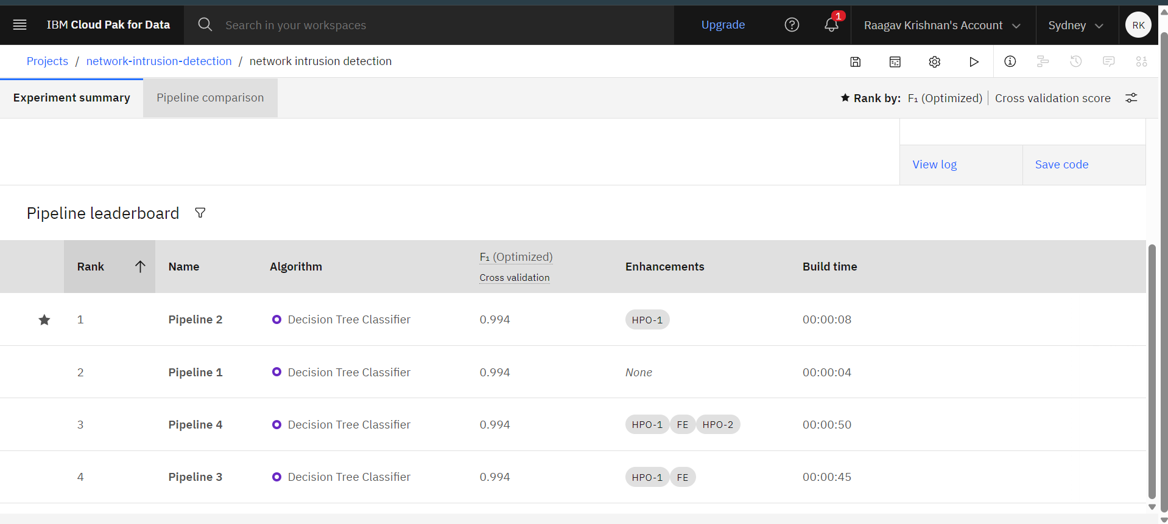
Best Model Screenshot:

Slide 9
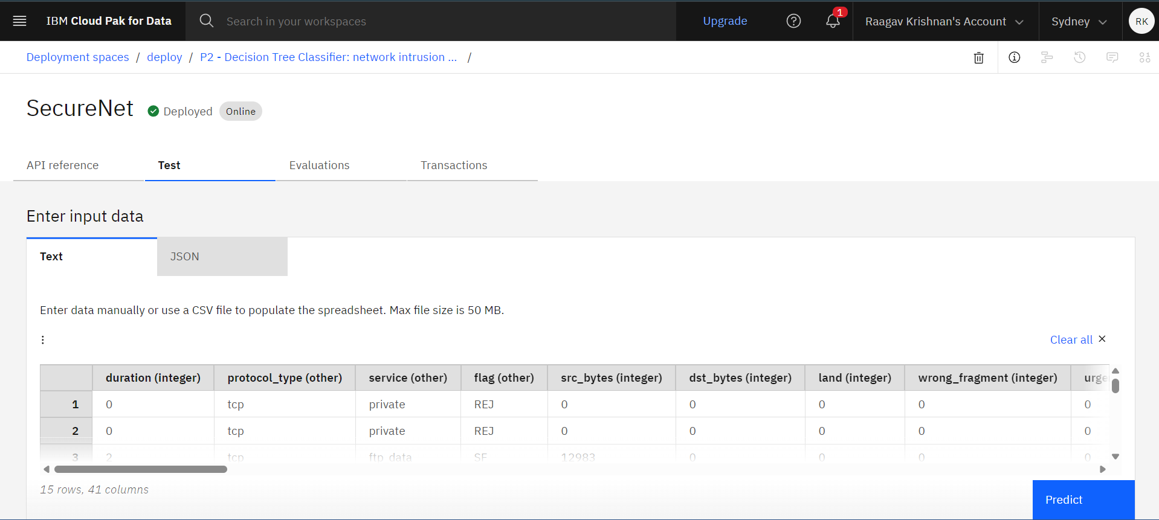
Testing Screenshot:

Slide 10
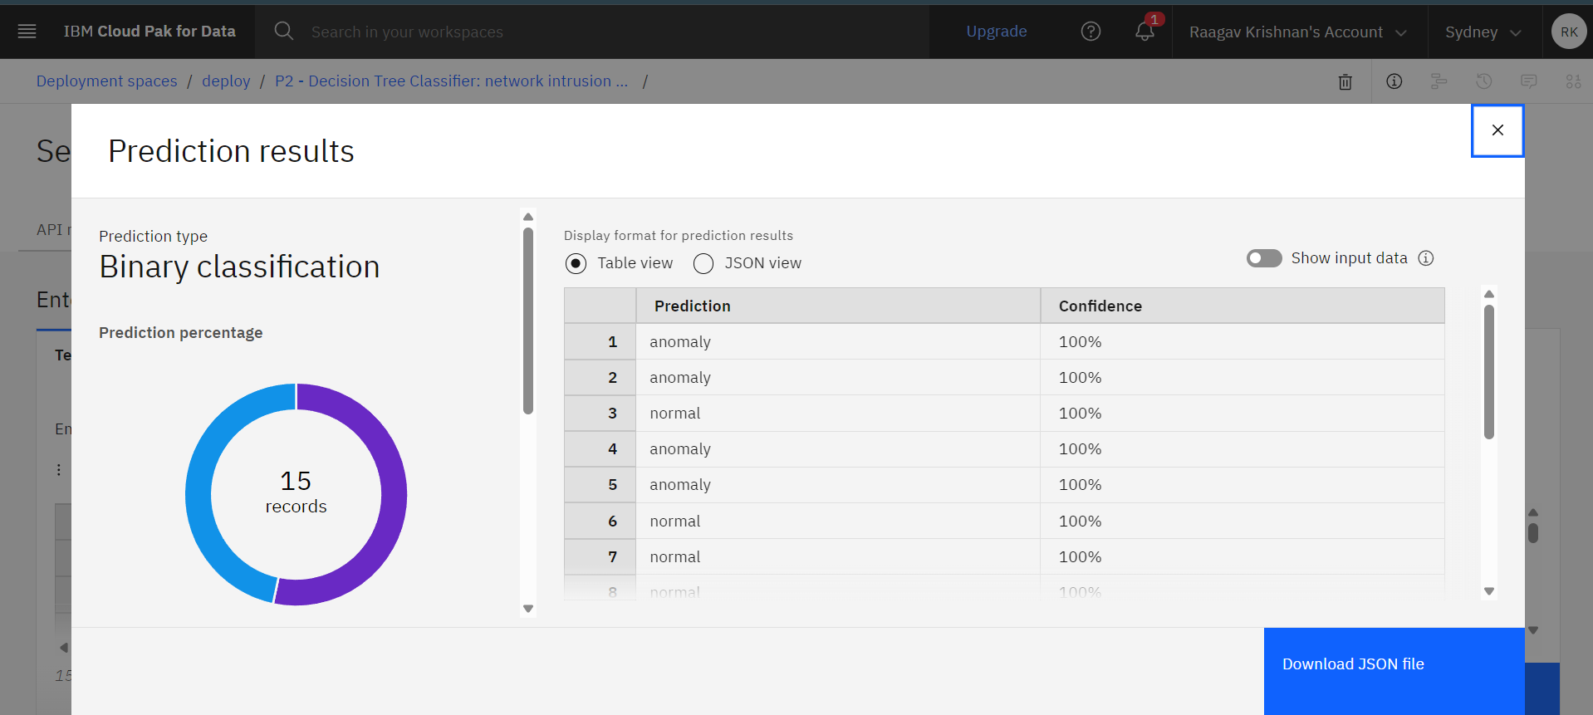
Testing Screenshot:

Slide 11
Novelty and Uniqueness
The solution automates network intrusion detection, reducing manual log monitoring effort and response time.
It uses IBM watsonx.ai AutoAI to automatically discover the best-performing machine learning model without extensive manual coding or algorithm selection.
The system goes beyond a black-box classifier by integrating IBM Granite to generate human-readable explanations for every flagged connection, helping security analysts understand *why* traffic was classified as anomalous.
The system can accurately classify network connections as normal or anomalous through a single intelligent platform, deployed as a live, testable REST API.
The model ensures consistent, automated threat detection, reducing reliance on manual rule-writing and minimizing missed or delayed detections.

Slide 12
Git Hub Link
GitHub Repository: https://github.com/Raagav-Krishnan/Network-Intrusion-detection
Deployed Application Link: https://network-intrusion-detection-14k5-3rfbywuoc.vercel.app/
Uploaded files:
data/ Train_data.csv , Test_data.csv
SB4UniversityEngagements_AICTE_Problem_Statements_2026.pdf (problem statement)
SecureNet AI project presentation.pptx
_P2 - Decision Tree Classifier_ network intrusion detection.ipynb (Python notebook downloaded from IBM Cloud)
·
·
·

Slide 13
Future Scope
The system can be integrated with live network traffic monitoring tools (e.g., NetFlow/sFlow exporters) to enable real-time intrusion detection instead of static, pre-extracted feature analysis.
Multi-class attack categorization (DoS, Probe, R2L, U2R) can be added, enabling more granular threat classification beyond binary normal/anomaly detection.
Integration with SIEM (Security Information and Event Management) tools can automate alerting and incident response workflows.
Advanced foundation models in IBM watsonx.ai can be used to continuously improve detection accuracy and explanation quality as new attack patterns emerge.
The solution can be scaled to support enterprise-level, multi-network deployments, providing organizations without dedicated security teams with accessible, explainable, automated threat detection.
·
·
·

Slide 14
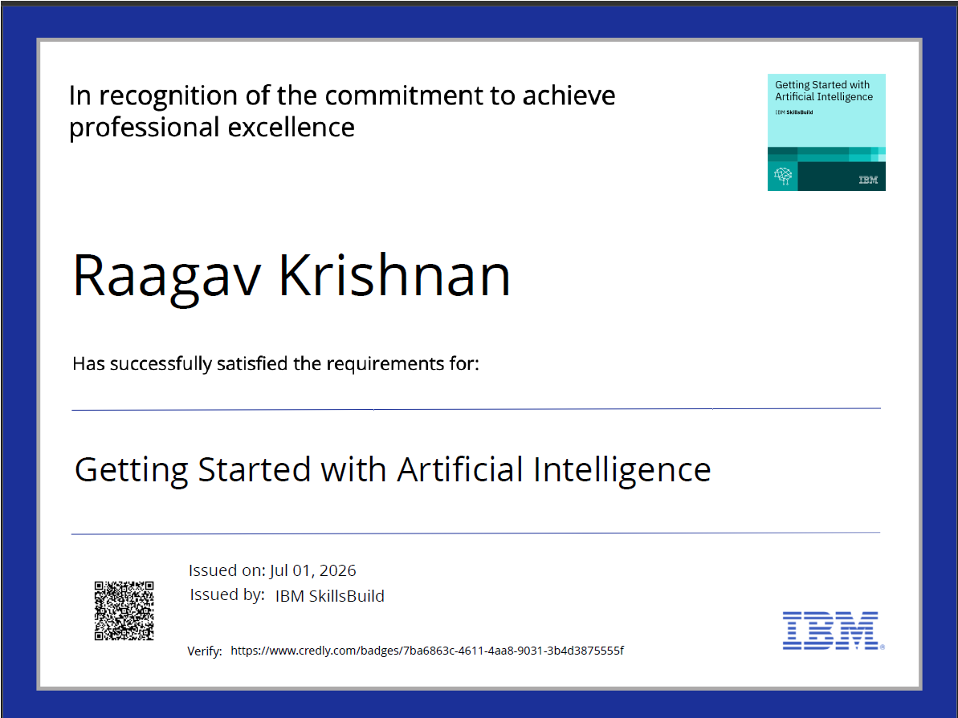
Certificates Earned:
Getting Started with AI Credly certificate

Slide 15
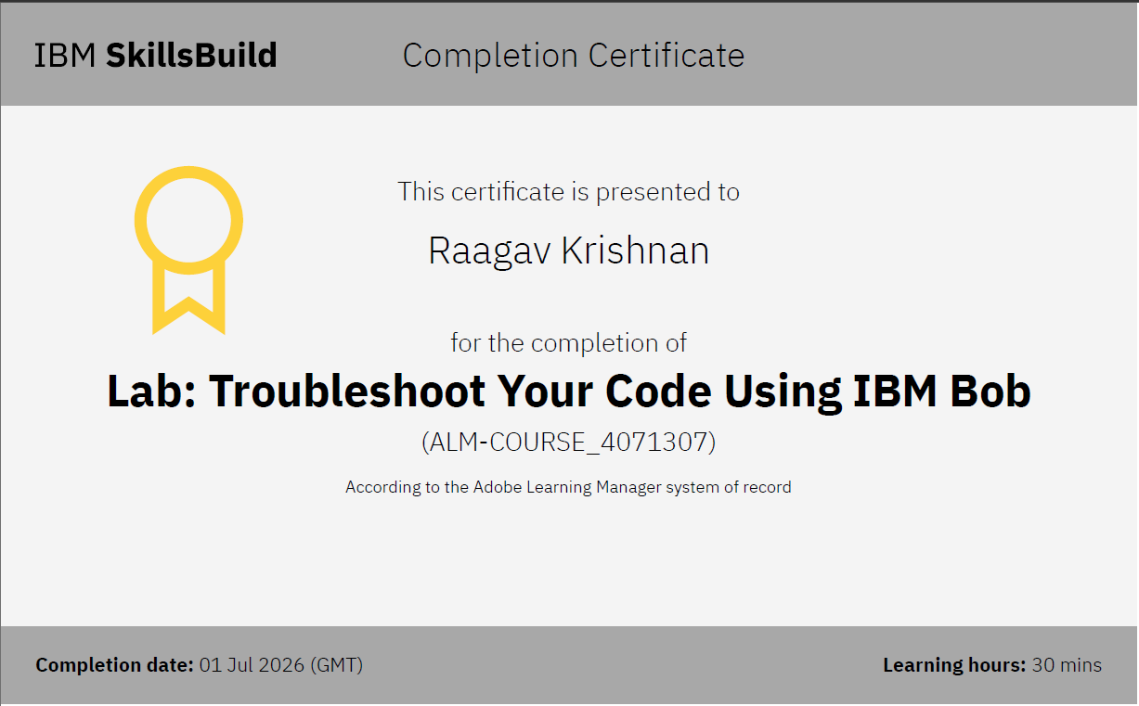
Certificates Earned:
IBM BOB Certificate

Slide 16


